Slide 1
Statistical Analysis in Maternal Health Conditions with Risk Factors
Group 22
Ming Luo
Yingnan He

Slide 2
Introduction
Problem Background and Definition
Explore the relationships between maternal risk level and medical parameters, then train the classification models
Classify pregnant women into the maternal risk levels with medical risk factors
Predictor 1
Low risk?
Mid risk?
High risk?
Predictor 2
Predictor 3
…

Slide 3
Overview
1
Data Collection and Exploration
2
Principal Component Analysis
3
Modeling and Model Selection
4
Model Performance Comparison

Slide 4

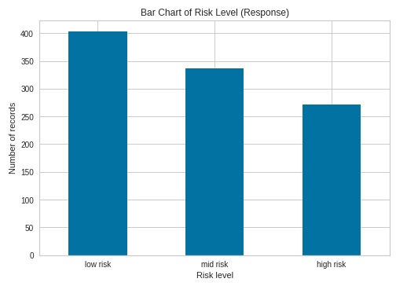
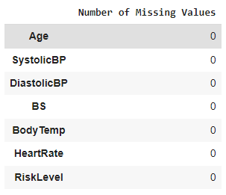
Dataset Overview
Data Collection and Exploration
Principal Component Analysis
Modeling and Model Selection
Model Performance Comparison
Balanced Dataset
1014 Records, 6 Predictors, and 1 Response Variable
Input Variables
Numeric Age (integer) Systolic Blood Pressure (SystolicBP) (integer) Diastolic Blood Pressure (DiastolicBP) (integer) Blood Sugar (BS) (float) Body Temperature (BodyTemp) (float) Heart Rate (integer)
Response Variable
Categorical Risk Level: Low, Mid, High (string)
No Missing Values

Slide 5
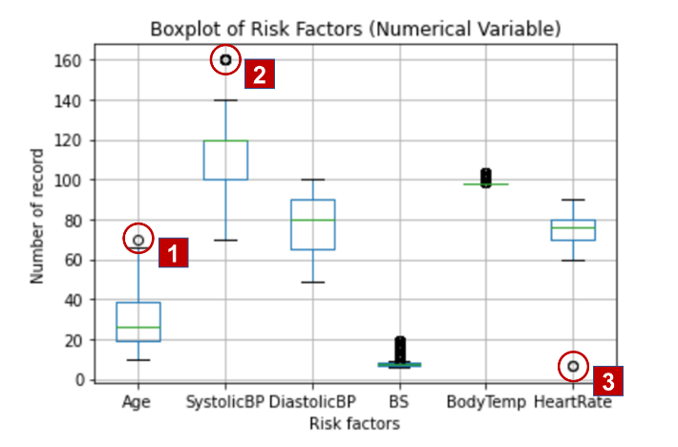
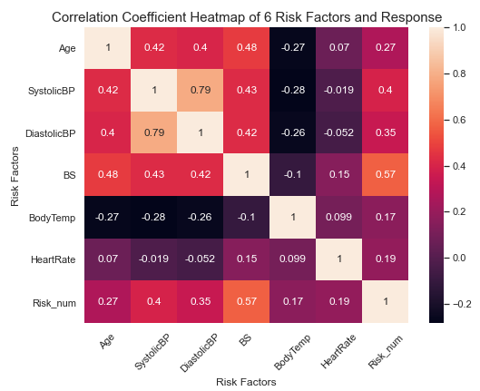




Data Processing
Data Collection and Exploration
Principal Component Analysis
Modeling and Model Selection
Model Performance Comparison
Drop Three Outliers
Drop One Highly Correlated Predictor
Age 70 and low risk level (impossible, 1 record)
SystolicBP with 160 and high risk (possible)
Heart Rate of 7 and low risk level (impossible, 2 records)
Therefore, we removed the 3 unreasonable records.
Systolic BP and Diastolic BP are highly correlated
Systolic BP is more related to the response
Therefore, Diastolic BP is dropped.

Slide 6
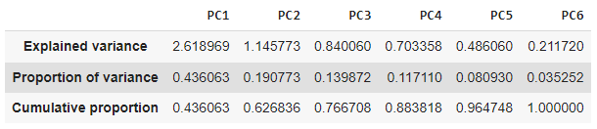
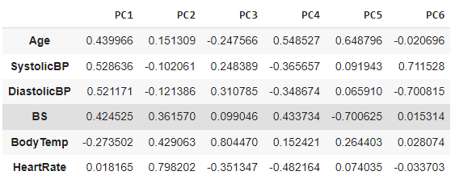
PCA Variance & Weights
Data Collection and Exploration
Principal Component Analysis
Modeling and Model Selection
Model Performance Comparison
Variance
First 2 PCs only capture 62.7% variance of predictors
Even first 3 PCs capture 76.7% variance
Weights
PC1 is dominated by variables age, blood pressure, as well as blood sugar.
PC 2 is dominated by variables heartrate and body temperature.

Slide 7
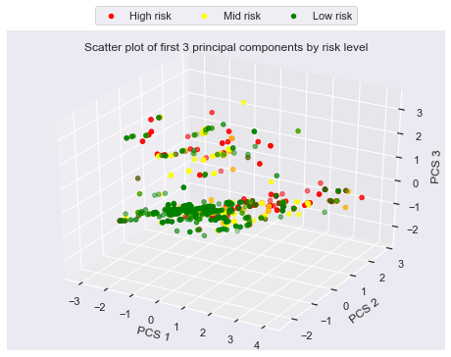
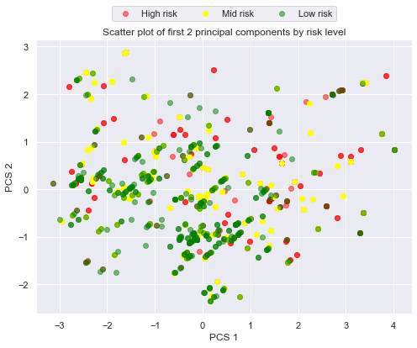
PCA Plotting
Data Collection and Exploration
Principal Component Analysis
Modeling and Model Selection
Model Performance Comparison
Plot data points on a 3D plane defined by the first 3 PCs
Plot data points on a 2D plane defined by the first 2 PCs
Because none of the first several components capture majority of variance in 6 predictors, PCA might not be a very helpful tool to predict the risk level of a pregnant woman.

Slide 8
Task specification and model selection
Data Collection and Exploration
Principal Component Analysis
Modeling and Model Selection
Model Performance Comparison
In this project, we are doing supervised learning.
In addition, since all the predictors are numeric and the output variable is categorical, we applied the following classification models to the Maternal Health Risk dataset.
K-Nearest Neighbors with Random Forest
Multinominal Logistic Regression
Gaussian Naïve Bayes
Decision Tree
Artificial Neural Networks

Slide 9
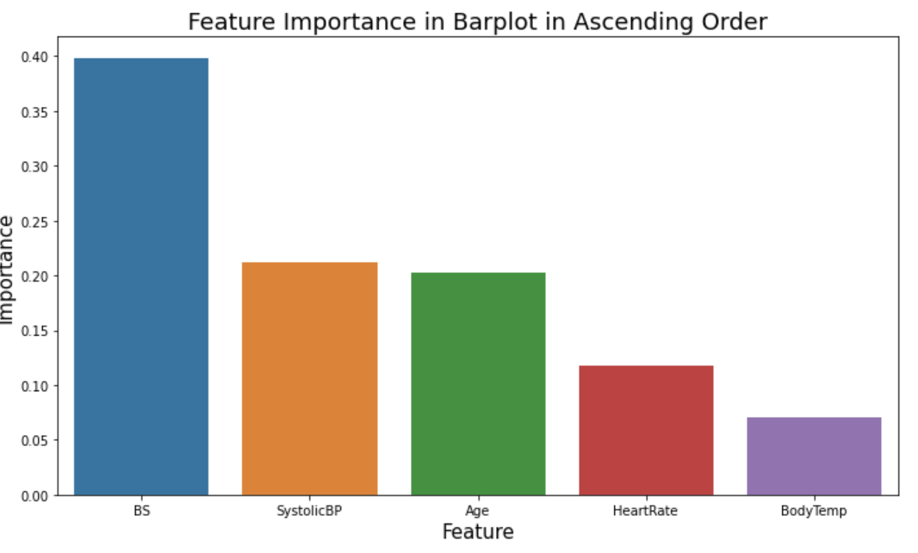
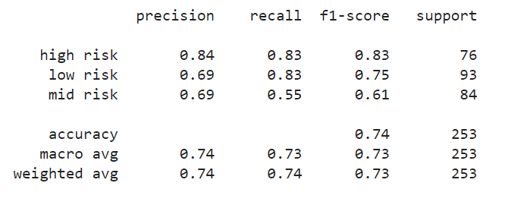
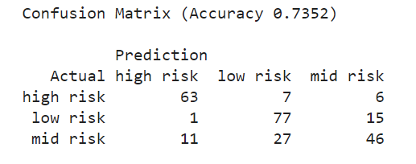
K-Nearest Neighbors with Random Forest
Data Collection and Exploration
Principal Component Analysis
Modeling and Model Selection
Model Performance Comparison
Apply the random forest model to do feature selection
Avoid curse of dimensionality
Classification performance is pretty good.
Naïve benchmark: 0.399
Accuracy score: 0.74
As a balanced dataset, macro average of recall (sensitivity) value: 0.73

Slide 10
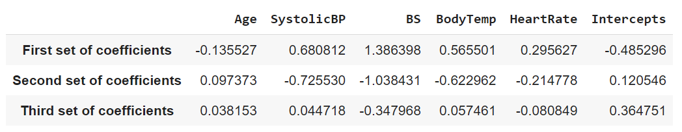
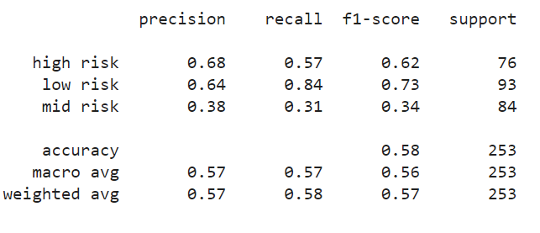
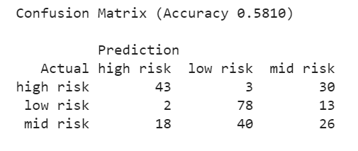
Multinominal Logistic Regression
Data Collection and Exploration
Principal Component Analysis
Modeling and Model Selection
Model Performance Comparison
Apply the multinominal logistic regression
The outcome has three classes
Classes have no meaning order
Classification performance is slightly better than random guess
Naïve benchmark: 0.399
Accuracy score: 0.58
As a balanced dataset, macro average of recall (sensitivity) value: 0.57

Slide 11
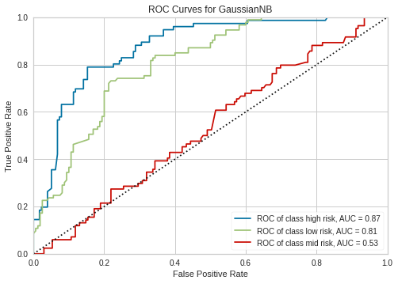
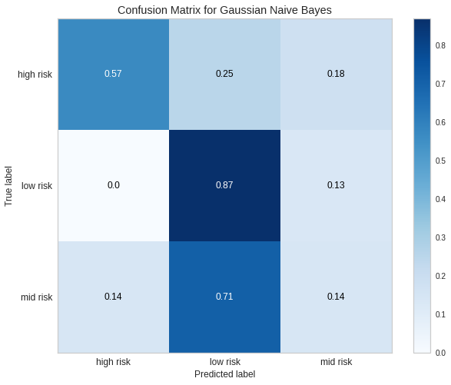
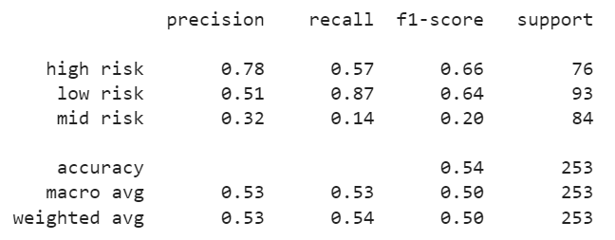
Gaussian Naïve Bayes
Data Collection and Exploration
Principal Component Analysis
Modeling and Model Selection
Model Performance Comparison
Assume that the predictors follow Gaussian distribution
Accuracy score: 0.54 (naïve benchmark: 0.399)
Precisions (positive predictive value) and recalls are not outstanding
AUC of mid risk group is close to 0.5 (randomly guessing)

Slide 12
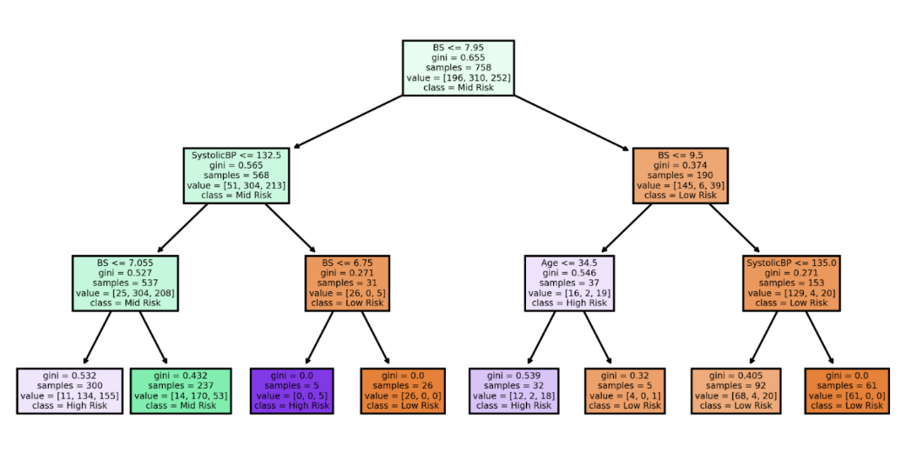
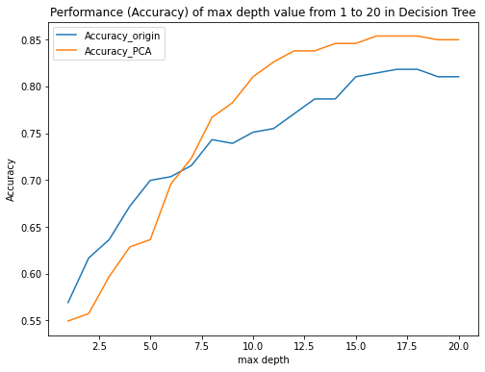
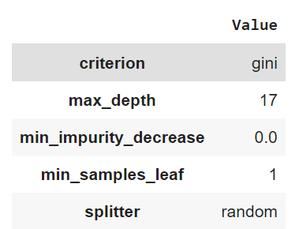
Decision Tree
Data Collection and Exploration
Principal Component Analysis
Modeling and Model Selection
Model Performance Comparison
Part 1 Grow an ideal tree
Three predictors, blood sugar, systolic blood pressure, and age are strong measures
PCA scores perform better as the max depth increases
Best combination of parameters
Find parameters by GridSearch
Grow a tree with max depth of 3
Accuracy with different max depth

Slide 13
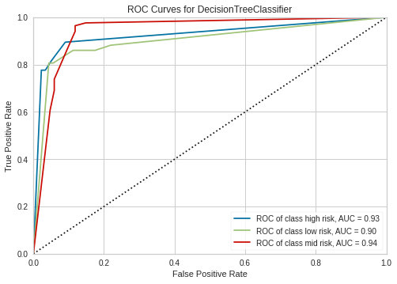
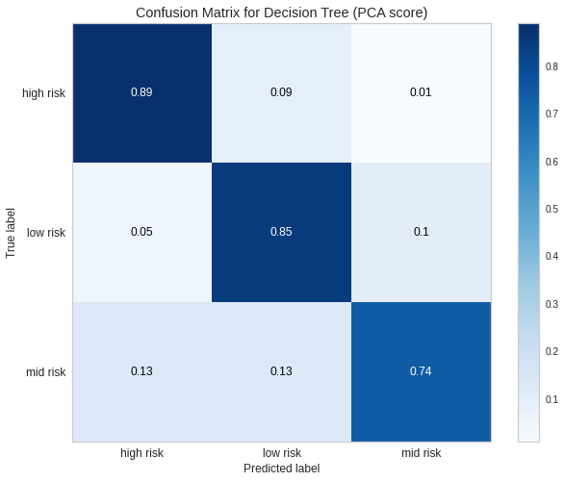
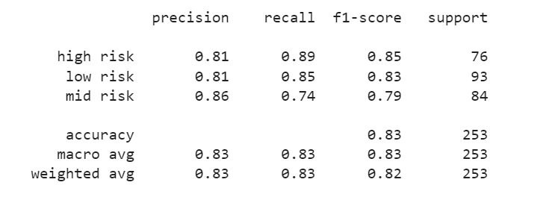
Decision Tree
Data Collection and Exploration
Principal Component Analysis
Modeling and Model Selection
Model Performance Comparison
Part 2 Modeling with PCA scores
Accuracy score: 0.83 (naïve benchmark: 0.399)
Precisions (positive predictive value): greater than 0.8
Recall rate (sensitivity) of high risk is 0.89
AUCs are higher than 0.9

Slide 14
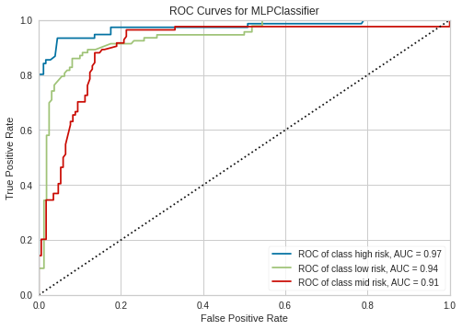
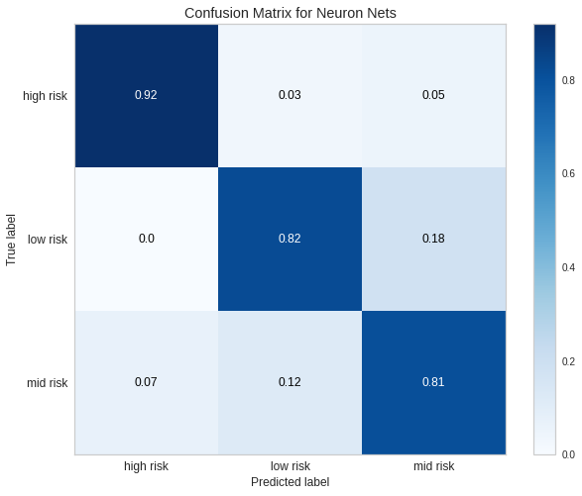
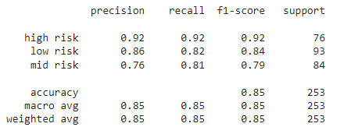
Artificial Neural Networks
Data Collection and Exploration
Principal Component Analysis
Modeling and Model Selection
Model Performance Comparison
ANN of 3 hidden layers with 10 nodes
Accuracy score: 0.85 (naïve benchmark: 0.399)
Precision (positive predictive value) of high risk: 0.92
Recall (sensitivity) of 3 groups: higher than 0.8
AUCs are higher than 0.9

Slide 15
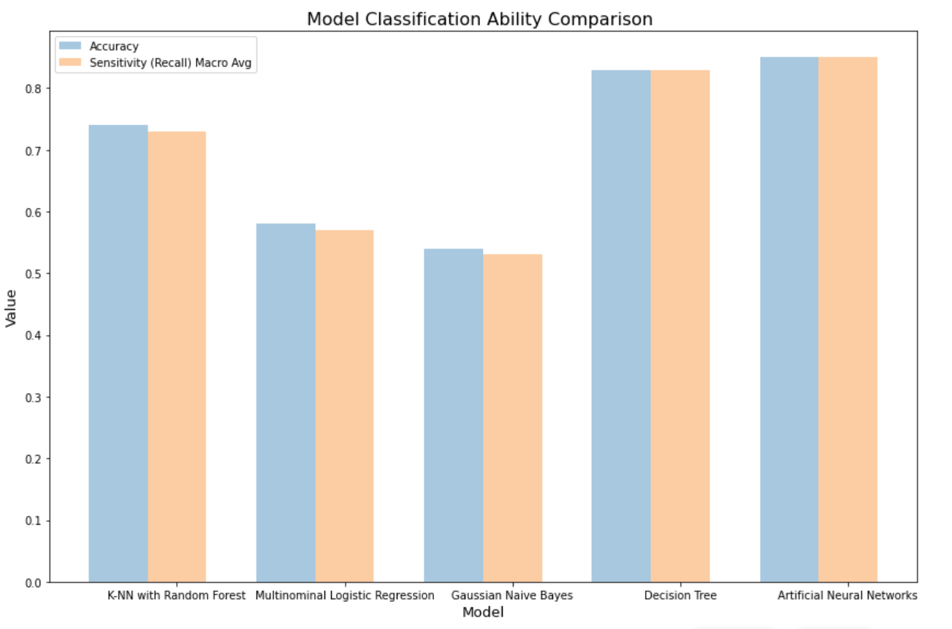
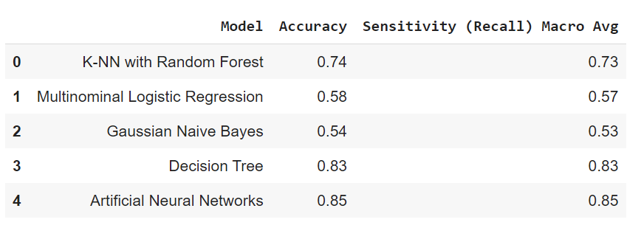
Models Performance Comparison
Data Collection and Exploration
Principal Component Analysis
Modeling and Model Selection
Model Performance Comparison
The best model is Artificial Neural Networks
Highest Accuracy
Highest Sensitivity (Recall) Macro Average value

Slide 16
Conclusion
a quick and reliable reference for medical experts
reduction on diagnostic cost required for patients
Physical Information
Age
Model
Artificial Neural Networks
Classification Output
Low Risk
Systolic Blood Pressure
Blood Sugar
Body Temperature
Heart Rate
Mid Risk
High Risk

Slide 17
Resources
United Nations. (n.d.). Goal 3 | Department of Economic and Social Affairs. United Nations. Retrieved January 29, 2022, from https://sdgs.un.org/goals/goal3
UCI Machine Learning Repository: Maternal Health Risk Data Set Data Set. (n.d.). Retrieved January 29, 2022, from http://archive.ics.uci.edu/ml/datasets/Maternal+Health+Risk+Data+Set#

Slide 18

Thank You! For Your Attention

